Slide 1
Design and Analysis of Algo
Spring 2026
Instructor: Dr. Hassan Dawood

Slide 2
Assessment Module
Assignments and Quiz’s(25%)
Mid. Exam (25%)
Final Exam (50%)
Min required attendance 75%.
No attendance (max 10 minutes late is accepted).
Classroom proxy is strictly prohibited.
Office hours: Wednesday 12:00 pm to 1:00 pm
@SED
“Don't make excuses, make good.”
Elbert Hubbard

Slide 3
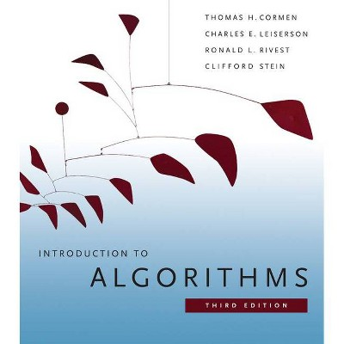
Introduction to Algorithms
Chapter 1: The Role of Algorithms in Computing

Slide 4

So you want to be a computer scientist?

Slide 5

Is your goal to be a mundane programmer?

Slide 6

Or a great leader and thinker?

Slide 7


Boss assigns task:
  Given today’s prices of pork, grain, sawdust, …
  Given constraints on what constitutes a hotdog.
  Make the cheapest hotdog.
Everyday industry asks these questions.

Slide 8
Your answer:
Um? Tell me what to code.
With more sophisticated software engineering systems,
the demand for mundane programmers will diminish.

Slide 9

Your answer:
I learned this great algorithm that will work.
Soon all known algorithms
will be available in libraries.
Your boss might change his mind. He now wants to make the most profitable hotdogs.

Slide 10
Your answer:
I can develop a new algorithm for you.
Great thinkers
will always be needed.

Slide 11
How do I become a great thinker?
Maybe I’ll never be…

Slide 12
Learn from the classical problems

Slide 13

Shortest path
end
Start

Slide 14
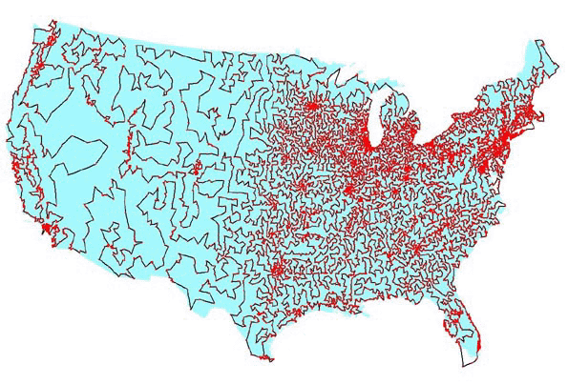

Traveling salesman problem

Slide 15
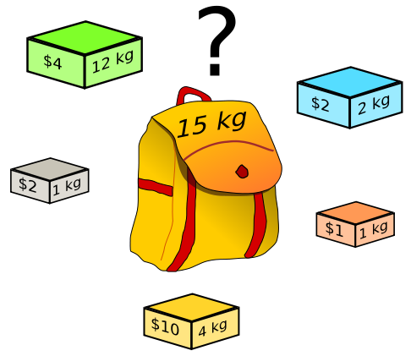
Knapsack problem

Slide 16
There is only a handful of classical problems.
  Nice algorithms have been designed for them
If you know how to solve a classical problem (e.g., the shortest-path problem), you can use it to do a lot of different things
  Abstract ideas from the classical problems
  Map your boss’ requirement to a classical problem
  Solve with classical algorithms
  Modify it if needed

Slide 17
What if you can NOT map your boss’ requirement to any existing classical problem?
How to design an algorithm by yourself?
Learn some meta algorithms
  A meta algorithm is a class of algorithms for solving similar abstract problems
  There is only a handful of them
    E.g. divide and conquer, greedy algorithm, dynamic programming
  Learn the ideas behind the meta algorithms
    Design a concrete algorithm for your task

Slide 18
Useful learning techniques
Read Ahead. Read the textbook before the lectures. This will facilitate more productive discussion during class.
Explain the material over and over again out loud to yourself, to each other, and to your stuffed bear.
Be creative. Ask questions: Why is it done this way and not that way?
Practice. Try to solve as many exercises in the textbook as you can.

Slide 19
What will we study?
Expressing algorithms
  Define a problem precisely and abstractly
  Presenting algorithms using pseudocode
Algorithm validation
  Prove that an algorithm is correct
Algorithm analysis
  Time and space complexity
  What problems are so hard that efficient algorithms are unlikely to exist
Designing algorithms
  Algorithms for classical problems
  Meta algorithms (classes of algorithms) and when you should use which

Slide 20
What is an algorithm?
Algorithms are the ideas behind computer programs.
An algorithm is the thing that stays the same whether the program is in Pascal running on a Windows or is in JAVA running on a Macintosh!

Slide 21
What is an algorithm? (cont’)
An algorithm is a precise and unambiguous specification of a sequence of steps that can be carried out to solve a given problem or to achieve a given condition.
An algorithm accepts some value or set of values as input and produces a value or set of values as output.
Algorithms are closely intertwined with the nature of the data structure of the input and output values

Slide 22
How to express algorithms?
English
Pseudocode
Real programming languages
Increasing precision
Ease of expression
Describe the ideas of an algorithm in English.
Use pseudocode to clarify sufficiently tricky details of the algorithm.

Slide 23
How to express algorithms?
English
Pseudocode
Real programming languages
Increasing precision
Ease of expression
To understand / describe an algorithm:
Get the big idea first.
Use pseudocode to clarify sufficiently tricky details

Slide 24
Example: sorting
Input: A sequence of N numbers a₁…a_{n}
Output: the permutation (reordering) of the input sequence such that a₁ ≤ a₂ … ≤ a_{n}.
Possible algorithms you’ve learned so far
  Insertion, selection, bubble, quick, merge, …
  More in this course
We seek algorithms that are both correct and efficient

Slide 25
Computational problems
A computational problem specifies an input-output relationship
  What does the input look like?
  What should the output be for each input?
Example:
  Input: an integer number n
  Output: Is the number prime?
Example:
  Input: A list of names of people
  Output: The same list sorted alphabetically

Slide 26
Algorithms
A tool for solving a well-specified computational problem
Algorithms must be:
  Correct: For each input produce an appropriate output
  Efficient: run as quickly as possible, and use as little memory as possible – more about this later
Input
Algorithm
Output

Slide 27
Algorithms Cont.
A well-defined computational procedure that takes some value, or set of values, as input and produces some value, or set of values, as output.
Written in a pseudo code which can be implemented in the language of programmer’s choice.

Slide 28
Correct and incorrect algorithms
Algorithm is correct if, for every input instance, it ends with the correct output. We say that a correct algorithm solves the given computational problem.
An incorrect algorithm might not end at all on some input instances, or it might end with an answer other than the desired one.
We shall be concerned only with correct algorithms.

Slide 29
Correctness
What makes a sorting algorithm correct?
  In the output sequence, the elements are ordered non-decreasingly
  Each element in the input sequence has a unique appearance in the output sequence
    [2 3 1] => [1 2 2] X
    [2 2 3 1] => [1 1 2 3] X

Slide 30
Correctness
For any algorithm, we must prove that it always returns the desired output for all legal instances of the problem.
For sorting, this means even if (1) the input is already sorted, or (2) it contains repeated elements.
Algorithm correctness is NOT obvious in some problems (e.g., optimization)

Slide 31
How to prove correctness?
Given a concrete input, eg. <4,2,6,1,7>
trace it and prove that it works.
Given an abstract input, eg. <a₁, … a_{n}>
trace it and prove that it works.
Sometimes it is easier to find a counterexample to show that an algorithm does NOT works.
  Think about all small examples
  Think about examples with extremes of big and small
  Think about examples with ties
  Failure to find a counterexample does NOT mean that the algorithm is correct

Slide 32
Problems and Algorithms
We need to solve a computational problem
  “Convert a weight in pounds to Kg”
An algorithm specifies how to solve it, e.g.:
  1. Read weight-in-pounds
  2. Calculate weight-in-Kg = weight-in-pounds * 0.455
  3. Print weight-in-Kg
A computer program is a computer-executable description of an algorithm

Slide 33

The Problem-solving Process
Analysis
Problem specification
Design
Algorithm
Implementation
Program
Compilation
Executable (solution)

Slide 34



From Algorithms to Programs
Problem
Algorithm: A sequence of instructions describing how to do a task (or process)
C++ Program

Slide 35
Practical Examples
Internet and Networks
  􀂄 The need to access large amount of information with the shortest time.
  􀂄 Problems of finding the best routs for the data to travel.
  􀂄 Algorithms for searching this large amount of data to quickly find the pages on which particular information resides.
Electronic Commerce
  􀂄 The ability of keeping the information (credit card numbers, passwords, bank statements) private, safe, and secure.
  􀂄 Algorithms involves encryption/decryption techniques.

Slide 36
Hard problems
We can identify the Efficiency of an algorithm from its speed (how long does the algorithm take to produce the result).
Some problems have unknown efficient solution.
These problems are called NP-complete problems.
If we can show that the problem is NP-complete, we can spend our time developing an efficient algorithm that gives a good, but not the best possible solution.

Slide 37
Components of an Algorithm
Variables and values
Instructions
Sequences
  A series of instructions
Procedures
  A named sequence of instructions
  we also use the following words to refer to a “Procedure” :
    Sub-routine
    Module
    Function

Slide 38
Components of an Algorithm Cont.
Selections
  An instruction that decides which of two possible sequences is executed
  The decision is based on true/false condition
Repetitions
  Also known as iteration or loop
Documentation
  Records what the algorithm does

Slide 39
A Simple Algorithm
INPUT: a sequence of n numbers
  T is an array of n elements
  T[1], T[2], …, T[n]
OUTPUT: the smallest number among them
Performance of this algorithm is a function of n
min = T[1]
for i = 2 to n do
{
if T[i] < min
min = T[i]
}
Output min

Slide 40
Greatest Common Divisor
The first algorithm “invented” in history was Euclid’s algorithm for finding the greatest common divisor (GCD) of two natural numbers
Definition: The GCD of two natural numbers x, y is the largest integer j that divides both (without remainder). i.e. mod(j, x)=0, mod(j, y)=0, and j is the largest integer with this property.
The GCD Problem:
  Input: natural numbers x, y
  Output: GCD(x,y) – their GCD

Slide 41
Euclid’s GCD Algorithm
GCD(x, y)
{
while (y != 0)
{
t = mod(x, y)
x = y
y = t
}
Output x
}

Slide 42
Euclid’s GCD Algorithm – sample run
while (y!=0) {
int temp = x%y;
x = y;
y = temp;
}
Example: Computing GCD(72,120)
temp x y
After 0 rounds -- 72 120
After 1 round 72 120 72
After 2 rounds 48 72 48
After 3 rounds 24 48 24
After 4 rounds 0 24 0
Output: 24

Slide 43
Algorithm Efficiency
Consider two sort algorithms
  Insertion sort
    takes c1n² to sort n items
    where c1 is a constant that does not depends on n
    it takes time roughly proportional to n²
  Merge Sort
    takes c2 n lg(n) to sort n items
    where c2 is also a constant that does not depends on n
    lg(n) stands for log₂ (n)
    it takes time roughly proportional to n lg(n)
Insertion sort usually has a smaller constant factor than merge sort
  so that, c1 < c2
Merge sort is faster than insertion sort for large input sizes

Slide 44
Algorithm Efficiency Cont.
Consider now:
  A faster computer A running insertion sort against
  A slower computer B running merge sort
  Both must sort an array of one million numbers
Suppose
  Computer A execute one billion (10⁹) instructions per second
  Computer B execute ten million (10⁷) instructions per second
  So computer A is 100 times faster than computer B
Assume that
  c₁ = 2 and c₂ = 50

Slide 45
Algorithm Efficiency Cont.
To sort one million numbers
  Computer A takes
    2 . (10⁶)² instructions
    10⁹ instructions/second
    = 2000 seconds
  Computer B takes
    50 . 10⁶ . lg(10⁶) instructions
    10⁷ instructions/second
    ≈ 100 seconds
By using algorithm whose running time grows more slowly, Computer B runs 20 times faster than Computer A
For ten million numbers
  Insertion sort takes ≈ 2.3 days
  Merge sort takes ≈ 20 minutes

Slide 46
Pseudo-code conventions
Algorithms are typically written in pseudo-code that is similar to C/C++ and JAVA.
Pseudo-code differs from real code with:
  It is not typically concerned with issues of software engineering.
  Issues of data abstraction, and error handling are often ignored.
Indentation indicates block structure.
The symbol "▹" indicates that the remainder of the line is a comment.
A multiple assignment of the form i ← j ← e assigns to both variables i and j the value of expression e; it should be treated as equivalent to the assignment j ← e followed by the assignment i ← j.

Slide 47
Pseudo-code conventions
Variables ( such as i, j, and key) are local to the given procedure. We shall not use global variables without explicit indication.
Array elements are accessed by specifying the array name followed by the index in square brackets. For example, A[i] indicates the ith element of the array A. The notation “…" is used to indicate a range of values within an array. Thus, A[1…j] indicates the sub-array of A consisting of the j elements A[1], A[2], . . . , A[j].
A particular attributes is accessed using the attributes name followed by the name of its object in square brackets.
  For example, we treat an array as an object with the attribute length indicating how many elements it contains( length[A]).

